Slide 1
Set up Dev Environment

Slide 2

React Development Tools
More on TypeScript with React in upcoming videos
You can use any text editor or IDE
•
Many React developers use the TypeScript language over JavaScript
•
Superset of JavaScript
•
Strongly-typed language with compile time checking and IDE support
•
Command-line tools to compile code and create React apps/components

Slide 3

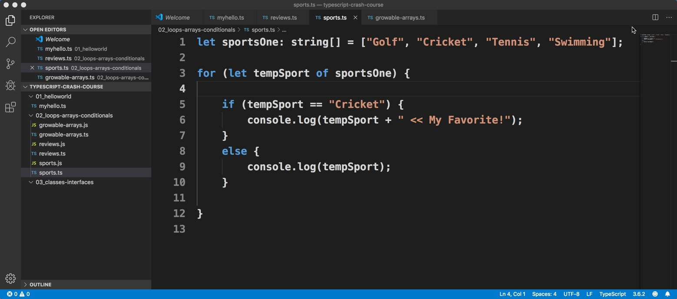
Visual Studio Code
Free IDE that supports multiple programming languages
Has built-in support for TypeScript and JavaScript
IDE features such as IntelliSense, Debugging, etc …
http://code.visualstudio.com

Slide 4





Command-Line Tools
Tool | Purpose
node | For running JavaScript code from command-line
npm | Node Package Manager - Download new node packages and features. Similar to Maven
tsc | TypeScript Compiler

Slide 5




Installation Instructions
Install tools: Visual Studio Code, node, npm, tsc
Step-by-step instructions for each operating system
MS Windows
Mac
Linux
•

